Slide 1
Mid Project Presentation
BHB Capstone project
Week 10

Slide 2
Learning Outcomes (LOs)
2 Work collaboratively, using professional and interpersonal skills, cooperative methods and communication with team members, project sponsor and advisor.
3 Apply the techniques and knowledge gained throughout the degree programme to research, analyse, design, develop, test and produce a solution
8 Effectively present the project experience and achievement to an audience including the project sponsor.

Slide 3
Attendees
Geoff (Client)
Olivia Hey (Project Manager)
Matt Baker
David Sushames
Samuel Davies

Slide 4
Topics
Brief description of project.
Milestones and deliverables that have been completed.
How progress has been made.
What is still to be done.
Any changes to timeframes that need to be discussed?
Overall client feedback/satisfaction.
Questions?

Slide 5
Brief description of project.
This project investigates the efficacy of the report output as generated by a human compared to an AI.

Slide 6
Milestones and deliverables that have been completed.
Project proposal completion
Client video completed

Slide 7
How progress has been made?
Progress has been made in various areas:
Tool Scope was expanded & subsequently reduced
Tools selected, Foremost, Wireshark and Nmap.
New Design Science Research Methodology adopted
Changed from LM studio to Ollama
Project philosophy change. (were going and finding AI tools and comparing them to non ai versions, now we are looking at tools and AI reports vs human reports.)
(changed what Geoff expects of us)

Slide 8
Foremost Proof of Concept
Foremost “carves” files from forensic disk images. Disk images are bit-by-bit copies of a storage medium. File carving is an essential practice in digital forensics.
The team developed a Python 3 script that is used to automate the examination of the “audit.txt” file from Foremost to produce a report.
The team also experimented with a script that directly inspects the carved files. Despite promising results, this has been commented out of the script because it has not been optimized yet.
The script also serves to record how long the process takes.
This effort represents the successful development/integration of AI enhancement to a digital forensics tool.

Slide 9
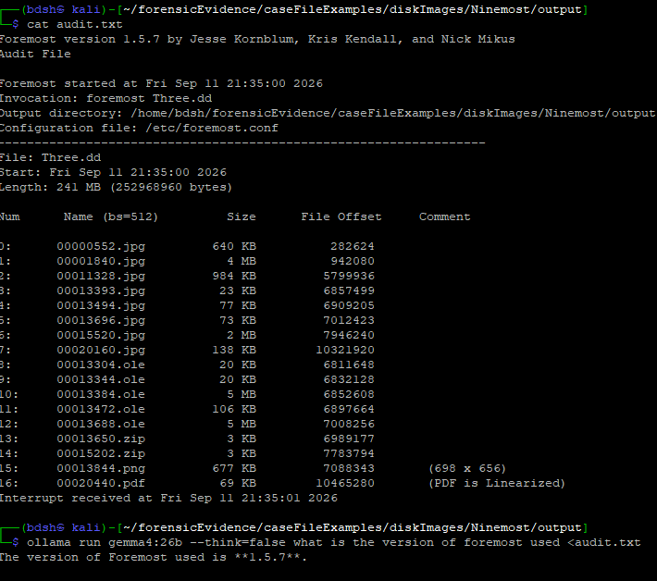
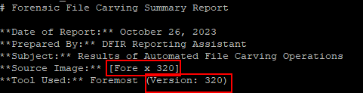
Emerging Insights
LLM falsifies names of the target disk image, and version of foremost used. This is because if audit.txt is too large, the context restricts the thinking to the lower half of the text file.

Slide 10
What is still to be done?
Complete proof of concepts for Wireshark and Nmap

Slide 11
Any changes to timeframes that need to be discussed?
The time frame has been shifted due to Capstone proposal taking longer than expected.

Slide 12
Overall client feedback/satisfaction

Slide 13
Questions?

